Slide 1
Cascading Style Sheets
(CSS)

Slide 2
Semantics vs Presentation (Review: previous classes)
Semantic markup is meant for consumption on a number of devices
HTML document is for the Structure of the webpage
CSS has the information on how the webpage should look like on the webpage
Notes:
What is Semantic markup ?
Header
Nav
Footer
Aside
Section
Article

Slide 3
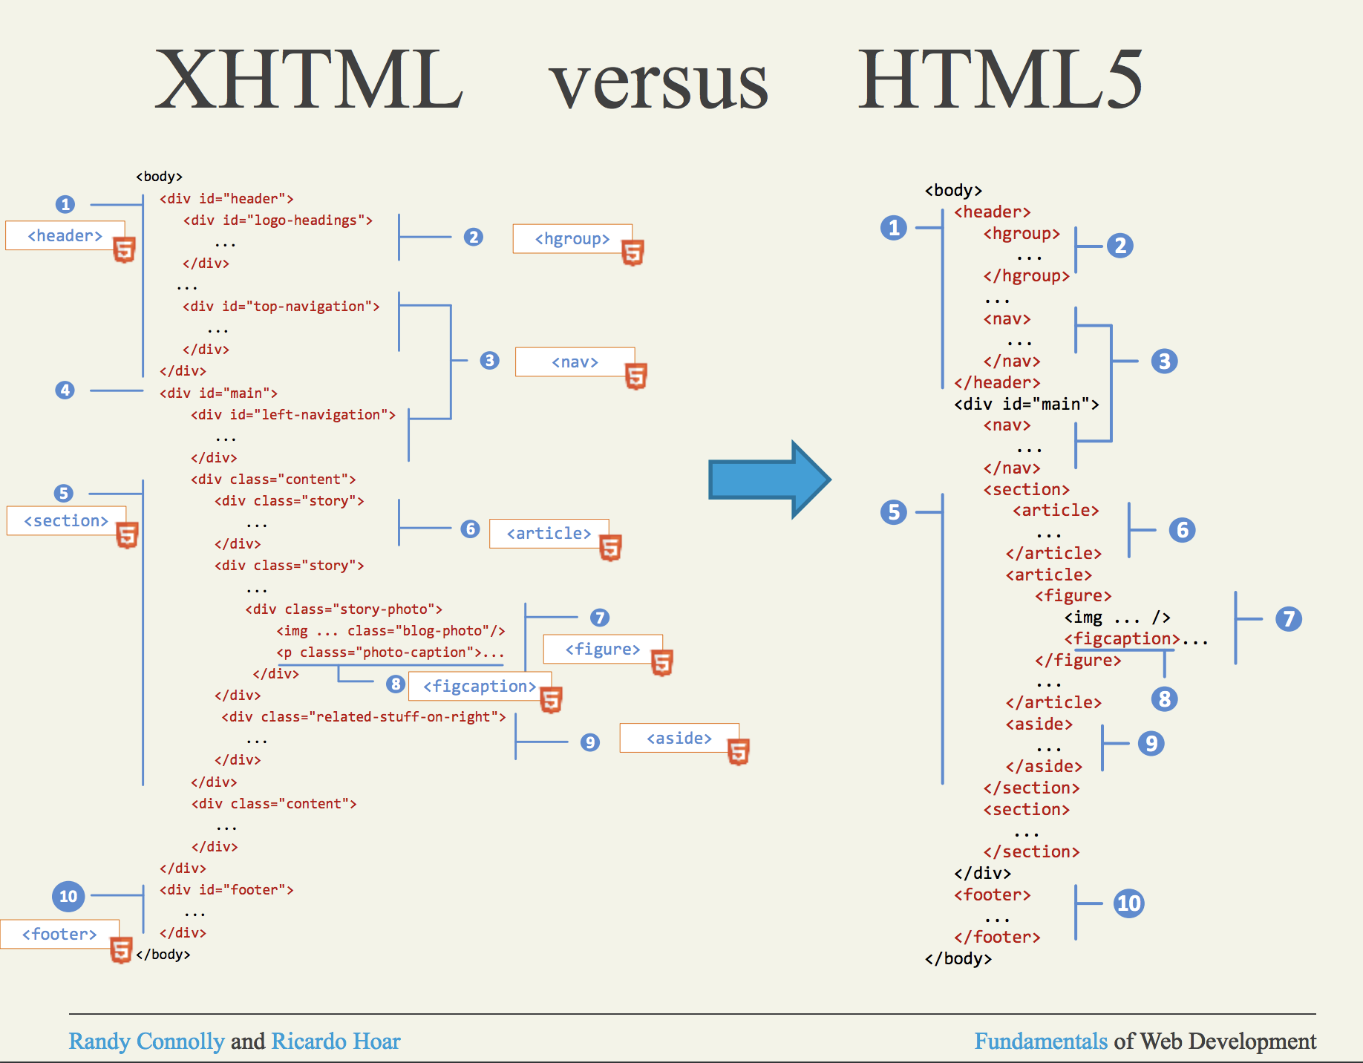
Notes:
XHTML no longer people are using it. Eveyone has moved to HTML5

Slide 4
What are the advantages of Semantic Markup ?
Eliminating presentation-oriented markup and writing semantic HTML markup has a variety of important advantages:
Maintainability. Semantic markup is easier to update and change than web pages that contain a great deal of presentation markup.
Faster. Semantic web pages are typically quicker to author and faster to download.
Accessibility. Visiting a web page using voice reading software can be a very frustrating experience if the site does not use semantic markup.
Search engine optimization. Semantic markup provides better instructions for search engines: it tells them what things are important content on the site.

Slide 5
Enter: Cascading Style Sheets
Language for dictating presentation on various devices
Can control presentation by
  Tag
  Attribute (id, class, sometimes others)
  Media type
  Resolution
Talking primarily about CSS 3
Notes:
sometimes others like JavaScript

Slide 6
Using CSS
<link>ed from the <head> in an external CSS file
  <link rel="stylesheet" type="text/css" href="style.css" />
<style> tag in the <head> containing CSS rules
style attribute on an element
External CSS should always be used where possible!
Notes:
rel = relation
There are two ways to add the CSS. Internally and externally
Internally by using the <style> tag
Externally, we will show you soon.

Slide 7
Anatomy of a Style Sheet
Any number of CSS Rules
Any number of /* Comments */
Notes:
In here This talks abut the Structure of the CSS

Slide 8
Anatomy of a CSS Rule
selector, ... {
declaration;
...;
}
Selectors dictate what the rule applies to
Declarations tell us what stylistic changes should be applied to these rules
Can have multiple selectors, declarations

Slide 9
CSS Selectors
Dictate what the rules apply to
Apply to...
  Tags (* is a wildcard, matches any element)
  IDs (prefix with #)
  Classes (prefix with .)

Slide 10
CSS Selectors
Comma-delimited if multiple selectors share the same rule
Ex: <p> or <address> or <h1>
      p, address, h1 {
      color:#f00;
      }

Slide 11
CSS Selectors
Interpreted as hierarchy when space-delimited without a comma
Ex: All <li> elements within a <ul> or all <li> within an <ol>
ul li, ol li {
color:#f00;
}
Notes:
https://www.w3schools.com/css/tryit.asp?filename=trycss_default

Slide 12
CSS Selectors
Classes/IDs can be searched alone or combined with elements
Classes are prefixed with '.’
IDs are prefixed with '#’
Ex: All <li> within an <ul> with the “nav” class
        ul.nav li {
        color:red;
        }
Notes:
.nav is the clas here

Slide 13
CSS Selectors
Multiple classes can be selected by using concatenation in the selector
Ex: All elements with class “nav” and also have class “sidebar”
.nav.sidebar {
color:#f00;
}

Slide 14
CSS Attribute Selectors
Can select based on the value of a given attribute
Follows an element, much in the same way as a class
Select using the form: E[attr=”value”]
img[alt=“foo”] {
border:5px #f00 solid;
}
Here we select all img tags with the alt atribute having a value of “foo” and set a border...

Slide 15
CSS Pseudo Selectors
Pseudo-classes
  Modifiers for existing elements
Pseudo-elements
  Select part of another element
  Select an element in relation to another
Syntax: baseselector:pseudoselector
  a:hover {
  background-color:blue;
  }

Slide 16
CSS Pseudo-classes
:link – hyperlinks (basically same as – a[href])
  a:link {} == a[href] {}
  If no href specified, each of the above will fail
:visited – visited links
:hover – hovering over with mouse
:active – clicking element
:focus – form control has focus

Slide 17
CSS Pseudo-elements
:before, :after
  Combined with the content property, adds content before or after the selected element and applies other CSS to it
:first-child
  Finds the first child of the element
  li:first-child
    <ul>
      <li>item 1</li>
      <li>item 2</li>
      </ul>

Slide 18
Anatomy of CSS Declarations
Dictate what changes to apply to the selected element (selected by its selector)
property: value;
  color:green;
A full list of properties can be found online. Do some Experiments!

Slide 19
CSS Properties: Text
font-family:
  List of fonts to try applying, must be on user's machine
  Selected font will be first ‘hit’ from left to right
  Separate fonts with commas, font names with whitespace are quoted.
  serif, sans-serif values can be used to find system defaults
  font-family: Garamond, “Times New Roman”, serif;
font-size: Text height
line-height: Spacing between each line

Slide 20
<aside> CSS Units
16px – pixels
1em – current font size – width of 1 “M”
100% - proportion of parent container
Also
In, cm, mm, ex, pt, pc
See this: https://www.w3.org/Style/Examples/007/units.en.html
Notes:
ex =
pt, pc

Slide 21
<aside> CSS Units
Old browsers don't let users resize pixel-based font sizes
Default font-sizes inconsistent
Solution: Set a consistent base font-size in pixels, use ems for text, line-height, etc
http://alistapart.com/article/howtosizetextincss

Slide 22
CSS Properties: Formatting
font-weight: Numeric or named weight, used to bold/lighten text
font-style: Used to italicize text
text-decoration: Used to underline/strikethrough

Slide 23
CSS Properties : Display
display:block;
  Display this element as if it were a block-level element
  That is – make a list out of inline tags (<a> for example)
display:inline;
  Display this element as if it were an inline element
  That is - Concatenate two block level elements (<p> maybe)
display:inline-block;
  Display elements inline, but keep block characteristics
  That is – creating columns without using float.
display:none;
  Don't display this at all

Slide 24
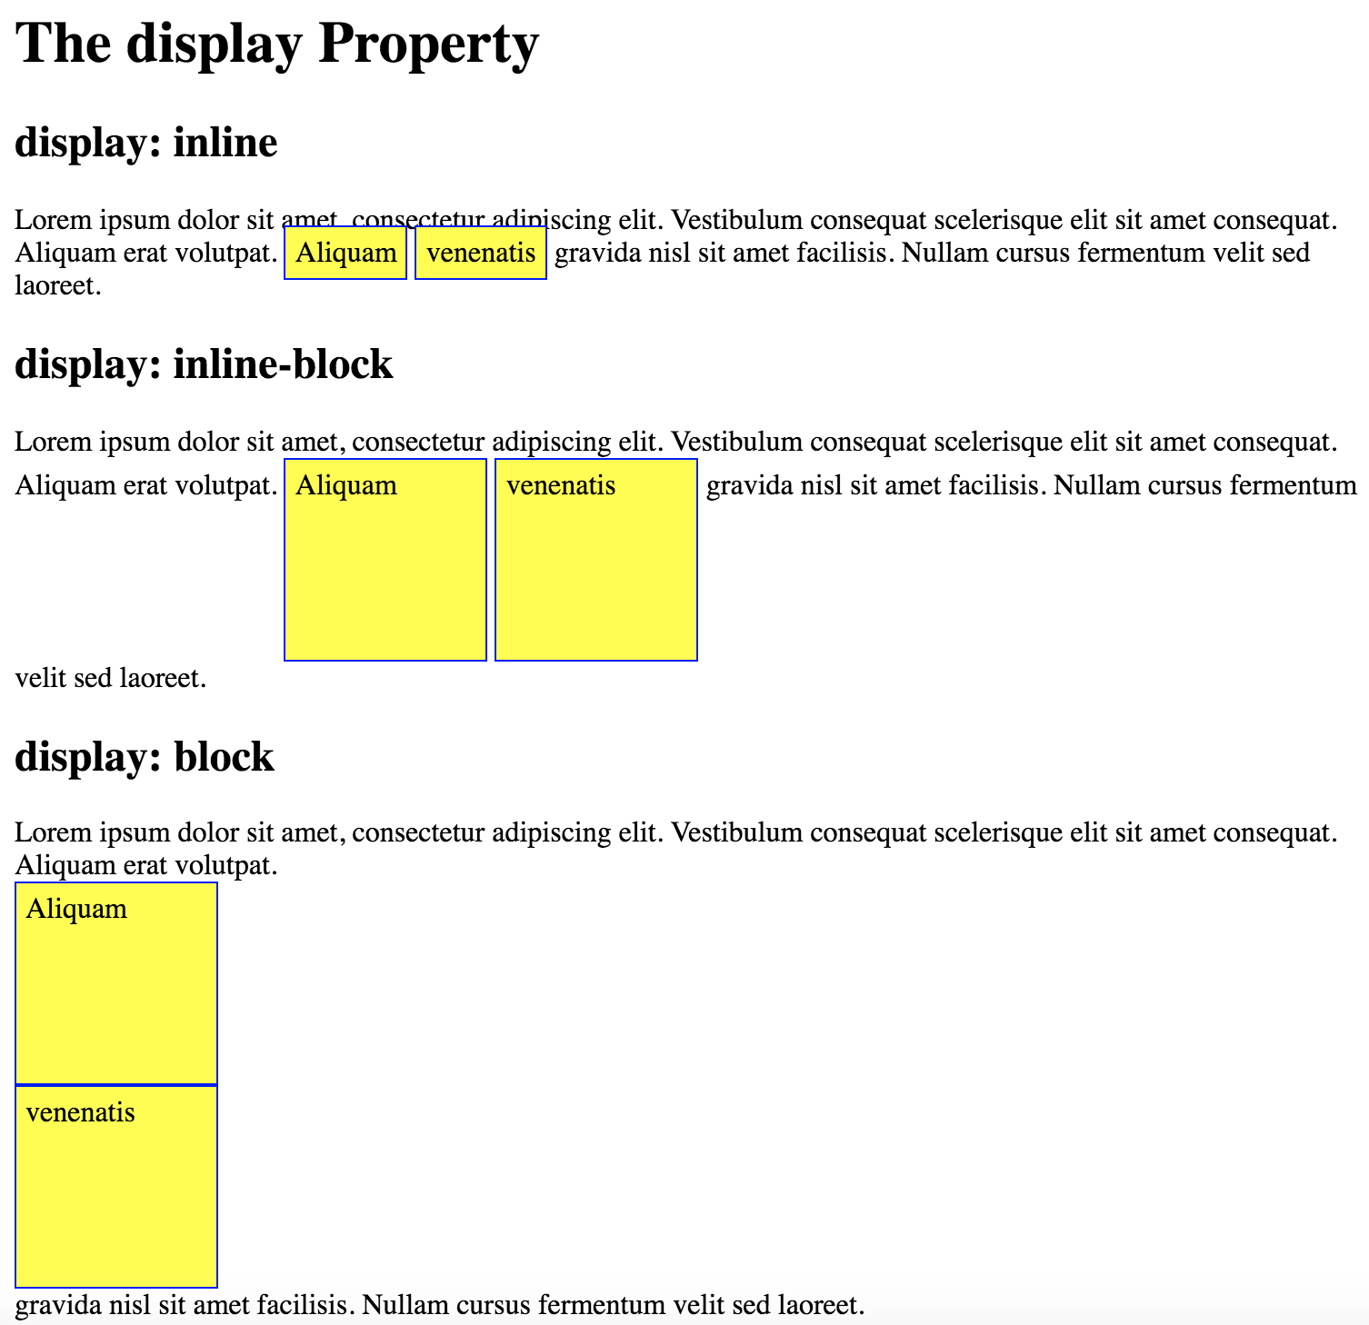
Notes:
https://www.w3schools.com/css/tryit.asp?filename=trycss_inline-block_span1

Slide 25
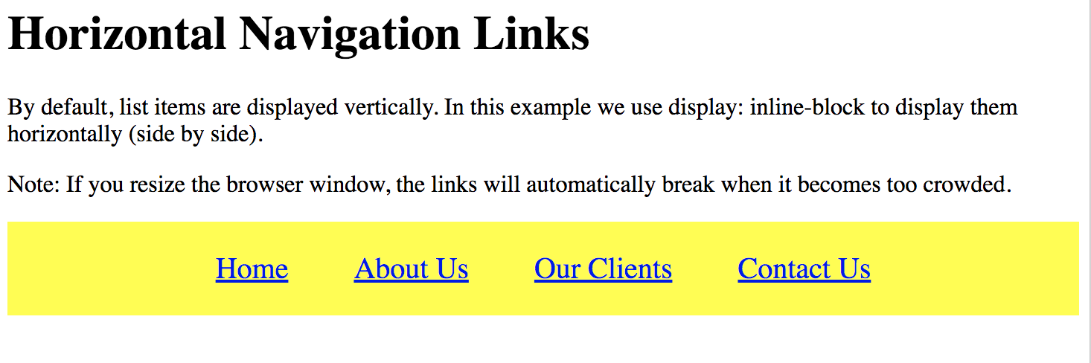
Good Use of “inline-block”
https://www.w3schools.com/css/tryit.asp?filename=trycss_inline-block_nav
Notes:
https://www.w3schools.com/css/tryit.asp?filename=trycss_inline-block_nav

Slide 26
CSS Properties : Visibility
visibility:hidden;
  Block out enough space to show this, then hide it
visibility:visible;
  Show any previously hidden elements
Remember,
  display removes from layout entirely,
  visibility only hides

Slide 27
CSS Box Model
Padding does not count toward element's base width/height (pushes text inward), but background color is applied
Border applied at the width boundary, affected by background color if no other is set
Margin applied outside the border, transparent
No spec for detailing what all default values should be for each!

Slide 28
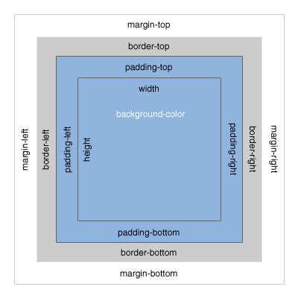
CSS Box Model
[Untitled graphic of the CSS Box Model, Bitmap].
Retrieved from http://www.mandalatv.net/itp/drivebys/css/

Slide 29
<aside> IE Box Model
IE7 and below has a non-standard implementation of the box model – can be turned on (see box-sizing)
Padding and border are included within the width, rather than added to it

Slide 30
CSS Properties: Box Model
width/height: Set the width and height of the element's bounding box
margin/padding: Set the margin (outside of the border) and padding (inside of the border) around the element
border: Set the size, color and style of the border around an element

Slide 31
CSS Properties: Positioning
position:static – default location in flow of the page – each element shows up immediately following the preceding
position:relative – block out the area where the element should be with relation to the preceding
position:absolute – remove element from flow of page, and position relative to document or closest relative-positioned parent
position:fixed – relative to browser window
top/left/bottom/right – amount to move from the supplied direction
https://www.w3schools.com/css/css_positioning.asp
Notes:
https://www.w3schools.com/css/css_positioning.asp

Slide 32
Floating Elements
Removes an element from the flow of the document
Pushes it to the farthest edge of the parent container, or next to a previously floated element if enough space exists
  If not enough space, jumps to the next line and pushed to the farthest edge
Commonly used in advanced layouts

Slide 33
CSS Properties : Float
float: Dictate which edge to float to, left or right
clear: Stop floating elements in the given direction from this point on (“both” allowed)
  Causes the container to wrap floated elements
Can avoid collapse with overflow method and some others...
More info
  http://css-tricks.com/all-about-floats/
  http://www.quirksmode.org/css/clearing.html

Slide 34
CSS Inheritance
Multiple rules matching the same element with different declarations will all take effect

Slide 35
CSS Specificity
When rules matching the same element with the same declaration conflict, the declaration's rule with the higher specificity will be used
Every selector has its place in the specificity hierarchy. There are four categories which define the specificity level of a selector:
  Inline styles - An inline style is attached directly to the element to be styled. Example: <h1 style="color: #ffffff;">.
  IDs - An ID is a unique identifier for the page elements, such as #navbar.
  Classes, attributes and pseudo-classes - This category includes .classes, [attributes] and pseudo-classes such as :hover, :focus etc.
  Elements and pseudo-elements - This category includes element names and pseudo-elements, such as h1, div, :before and :after.
Equal specificity: the latest rule counts - If the same rule is written twice into the external style sheet, then the lower rule in the style sheet is closer to the element to be styled, and therefore will be applied:
Note: Specificity is a common reason why your CSS-rules don't apply to some elements,
although you think they should.
https://www.w3schools.com/css/css_specificity.asp
Notes:
https://www.w3schools.com/css/css_specificity.asp

Slide 36
Computing Specificity (W3C)
A = Is this an inline style (using the style attribute)?
  Yes = 1, otherwise 0
B = Number of ID selectors
C = Number of classes, attributes and pseudo- classes
D = Number of elements and pseudo-elements
#mainpanel .morningstar ul li:first-child ➔0122
A = 0, B=1, C=1+0+1, D=1+1

Slide 37
Computing Specificity
Compare A, use greater
If tied, compare B, use greater
If tied, compare C, use greater
If tied, compare D, use greater
If tied, use the rule defined last

Slide 38
Computing Specificity (StarWars)
Start at 0 (zero)
Add 1 for every element and pseudo-element (that is: li or :first-child)
Add 10 for each attribute (that is: [href=“example.com”])
Add 10 for each class and pseudo-class (that is .container and :hover)
Add 100 for each ID
Add 1000 for inline style
#mainpanel .morningstar ul li:first-child ➔113
More info: http://www.stuffandnonsense.co.uk/archives/css_specificity_wars.html

Slide 39
Browser Inconsistencies
HTML 4.01 lets browsers handle default rendering as they see fit in many cases
Leads to many minor inconsistencies between browsers
HTML5 tries to address this by writing defaults into the spec

Slide 40
Browser Inconsistencies
So what do we do?
  CSS Resets
  CSS Hacks
  Conditional comments (IE)
  Vendor prefixes
    Nice tool HTML4.01 and CSS 2.1 or earlier - Prefixr
A neat resource when coding for multiple browsers:
  http://caniuse.com/

Slide 41
Solution: CSS Resets
Used to address browser inconsistencies in default rendering
Common base styles to work from
Example rule: Setting all margins and padding to 0
Some common scripts used by many : http://www.cssreset.com/

Slide 42
CSS Hacks
Exploit some browser bugs to fix others
Problem: What happens when the bug you rely on gets fixed?
Generally, there's no reason (anymore) to use them...

Slide 43
IE Conditional Comments
IE allows the parsing of content within a comment that marks it for use with specific IE versions
<!--[if gte IE 6]>Show to IE versions 6 and up, inclusive<![endif]-->
gte can be substituted
  (none): exact match
  gt: greater than
  lt: less than
  lte: Less than or equal to

Slide 44
IE Conditional Comments
IE will also treat content wrapped between two closed comments as commented itself
<!--[if !IE]> -->Hide from IE<!-- <![endif]-->

Slide 45
IE Conditional Comments
Best practice: When an IE version needs different CSS...
  Conditional comment for that IE version in head
  Supply a new stylesheet after your main stylesheet

Slide 46
Why CSS?
Decouple presentation from semantic meaning of document
Reuse style information
Easy to make consistent changes

Slide 47
Tools of the trade
Browsers. Lots of browsers.
  Chrome
  Firefox
  Safari
  Opera
  Internet Explorer/Edge

Slide 48
Tools of the trade
VirtualBox or other VM (Mac/Linux)
  VirtualBox – Free – Windows/Mac/Linux
  Parallels – about $80 – Windows/Mac/Linux
  Vmware – Free & Paid – Windows (workstation)/Mac (Fusion)/Linux

Slide 49
Tools of the trade
Browser utilities let you examine the box model, computed CSS properties, etc.
  Chrome: Chrome Developer Tools
  Firefox: Firebug, Web Developer Toolbar
  IE: IE Developer Tools
  Etc.
Notes:
--allow-file-access-from-files

Slide 50
Tools of the trade
A text editor
  Command line: emacs, vi, etc
  GUI-based: Sublime, Atom, Brackets, Notepad++, Coda, ...
  Full IDE: Dreamweaver, Eclipse, etc.
The best editor is the one that you are most comfortable and efficient with
Notes:
Vi = VIM text editor
My personal best editor is Sublime

Slide 51
<aside> Links
CSS Properties - W3
http://alistapart.com/article/howtosizetextincss
display:inline-block
Positioning
Float
http://css-tricks.com/all-about-floats/
http://www.quirksmode.org/css/clearing.html
StarWars
http://www.stuffandnonsense.co.uk/archives/css_specificity_wars.html
http://caniuse.com/
http://www.cssreset.com/
Notes:
Some additional reading for you …

Slide 52

<code>
Create a simple HTML signature for your email.

Slide 53
End of the today’s class…
Lab 2 – XML, HTML and CSS
Labs are generally not required to work cross- browser...
but homework assignments and your Term projects are!

